Slide 1

AI Project
pAcman game

Slide 2
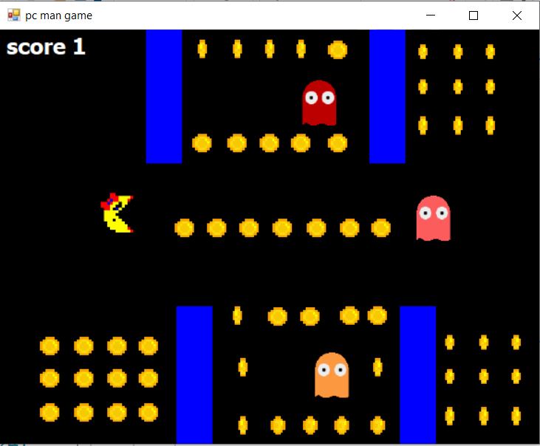
PEAS
P → Performance → speed ,high score
E → Environment → ghost , wall
A → Actuator → screen display
S → Sensor → location ghost and
pac-man

Slide 3
ODESA
O → Observability → fully observable
D → Deterministic → Deterministic
E → Episode → Sequential
S → Static → Static
A → agent → Single Agent

